Slide 1
SMART GLOVE WITH GESTURE RECOGNITION ABILITY FOR HEARING AND SPEECH IMPAIRED
BY
ADITI SHENOY 116A2004
AKSHAY PRAKASH 116A2007
ATIF ATEEQUE 116A2011
PRANAV MENON 116A2070
UNDER GUIDANCE OF
PROF. KINTU PATEL

Slide 2
INTRODUCTION
One of the most precious gifts to a human being is an ability to see, listen, speak and respond according to the situations. But there are some unfortunate ones who are deprived of this.
When a speech impaired person speaks to a normal person, the normal person finds it difficult to understand and asks the deaf and dumb person to show gestures for his/her needs.
It is necessary to have an advance gesture recognition or sign language detection system to bridge this communication gap.
Smart glove has been designed to give voice to the voiceless and its main objective is to help deaf and dumb people by removing communication barrier so they are not restricted in a small social circle and are also able to convey their feelings and emotions.

Slide 3
LITERATURE SURVEY
Glove Talk II is a system which translates hand gestures to speech, which is based on the gesture format model developed by Sidney Fels and Geoffrey Hinton, Department of Computer Science of University of Toronto[2]. Neural networks were used to implement an adaptive interface, called Glove Talk II, which contains hand gestures to control the parameters of a parallel formant speech synthesizer to allow a user to speak with his hands. (IEEE Transaction on Neural Networks).
Harmeet Kaur, et al. in their paper, presented a brief description about the past attempts that were made to convert sign language to understandable form. In their paper, they have thoroughly scrutinized the previous attempts over this technology and also suggested various possible ways to implement the design of a simple smart glove[4]. (IJSRMS 2016)
Speak Jet is a sound synthesizer which is used to convert text data into voice. It uses Mathematical Sound Architecture (MSA) technique to control five channel sound synthesizer to generate speech signal. (Speak jet Inc. USA)
Tushar Chouhan et al. implemented wired interactive glove, interfaced with a computer running MATLAB or octave, with a high degree of accuracy for gesture recognition. The glove maps the orientation of the hand and fingers with the help of bend sensors, Hall Effect sensors and an accelerometer. The data is then transmitted to a computer using automatic repeat request as a error controlling scheme. (IEEE Humanitarian Technology Conference 2014)

Slide 4
LITERATURE SURVEY
Abhishek Tandon, et al. in their paper proposed design of their glove converts the Indian Sign Language (ISL) into text and speech. Their proposed design consists of five flex sensors, one for each finger of the hand. These flex sensors are connected to five analog inputs of the microcontroller. They used microcontroller to process input voltage of the 7 flex sensors and send the desired text output to the android device (smart phone) using Bluetooth module. Their android device has a software application which can convert the text into audible (speech) signals (IJSRD 2016)

Slide 5
PROPOSED SYSTEM
In the proposed system, The approach is used with microcontroller(Arduino)and sensor based data glove.
The glove is internally equipped with flex sensors and MPU 6050 . For every specific gesture, the flex detector produces a proportional modification in resistance and measures the orientation of hand.
The process of those hand gestures is finished in controller.
The gestures made are compared within database and output is generated.

Slide 6
METHODOLOGY
A. Hardware Assembly
Five flex sensors were attached on the thumb, index, middle, ring and small finger in order to measure the bent of the fingers and the clench of the hand.
Then accelerometer and the gyroscope of MPU6050 was placed on the back of the hand in order to determine the position and movement of the hand on space.
Arduino Mega has been programmed so that it sent 11 data's from all the sensor which are 5 flex sensor information, 3 accelerometer information and 3 gyroscope data taken at duration of 500ms to its serial port.
Arduino was connected to the serial port of the computer and by the use of python programming language the data at the serial port was gathered.

Slide 7
B. Dataset Preparation
Dataset Collection
We created the datasets for training the machine using the data which was collected at the serial port of Arduino and then we stored those values in csv file format.
This data consists of eleven values i.e. five from the flex sensors and three each from the accelerometer and gyroscope respectively.
The data which was collected was for those words that are used very often.
Data Pre-Processing
The information which was collected was then segregated with their respective word as the final or expected value.
The final data which was collected was randomized so as to reduce the change and to ensure that the model stays general and over fits less.
C. System Block Diagram
Feature extraction diagram is shown

Slide 8
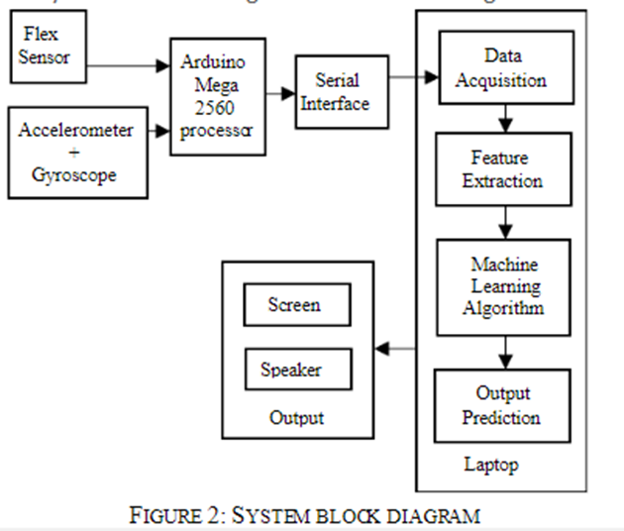
SYSTEM ARCHITECTURE
When hand motion is made by the handler, user gives eleven inputs from the glove controller to the system which consists of three axes accelerometer signal, three- axes gyroscope signal and five flex sensor signals.
These eleven values that are taken from the user acts as a key in identifying a specific signal.
These features the gestures is then passed through random forest classifier, and then the gestures are classified according to the features, and the output is predicted.
When we do a specific gesture using the glove, the data from the sensors and MPU were collected. The processing was done using Arduino. This was used to obtain proper output. After getting the data it was sent to the serial port.
Using python we collected and stored that temporary data.
Using feature extraction the data was collected. The appropriate output was then predicted for the given gesture.
This output is reflected on the computer screen or the speaker.

Slide 9
HARDWARE AND SOFTWARE REQUIREMENTS
Flex sensors
Arduino Mega 2560
Gloves
MPU 6050
Arduino IDE
Machine Learning- Python(Pycharm IDE)
Tera Term

Slide 10
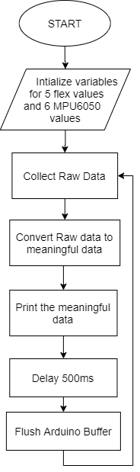
Process Of Dataset Preparation using
Arduino(Collecting Raw values)
Process Of Dataset Preparation using Python(Making a trained model)

Slide 11
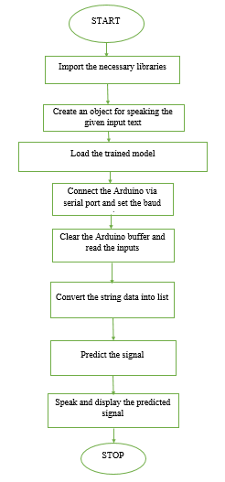
Processing at Real time

Slide 12
MACHINE LEARNING: RANDOM FOREST CLASSIFIER
Random forest Algorithm which is based on the concept of ensemble learning is used for classification or regression.
Random forests creates decision trees on randomly selected data samples, gets prediction from each tree and selects the best solution by means of voting. It also provides a pretty good indication of the feature importance.
Random forests has a variety of applications, such as image classification and feature selection.
Random forest is considered to be very accurate and a powerful method.

Slide 13
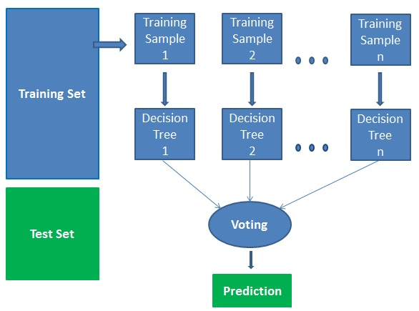
HOW DOES THE ALGORITHM WORK?
It works in four steps:
Select random samples from a given dataset.
Construct a decision tree for each sample and get a prediction result from each decision tree.
Perform a vote for each predicted result.
Select the prediction result with the most votes as the final prediction.

Slide 14
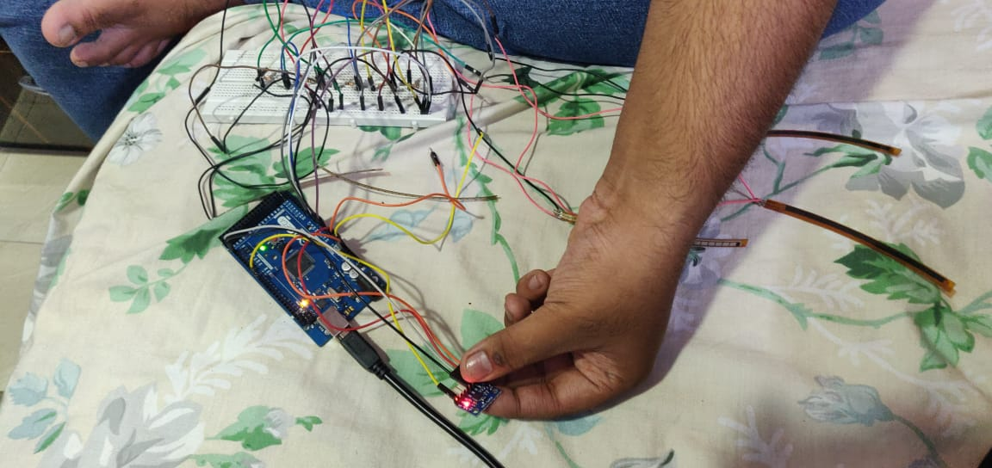
RESULTS
The model was prepared and made using the datasets of the most regularly used words.
At that point, dataset for some of the letters in order were joined and rearranged so as to prepare the machine with diminished change and to ensure that the model
stays general and over fits less.The information obtained was taken for communication via gestures of the letters or words, it went through the prepared machine and the nearest estimation was played and shown.

Slide 15
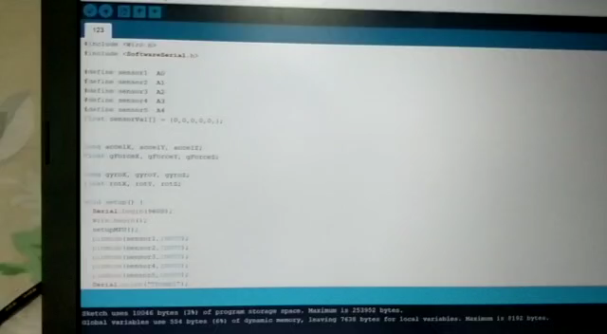
Collecting Raw values from sensors

Slide 16
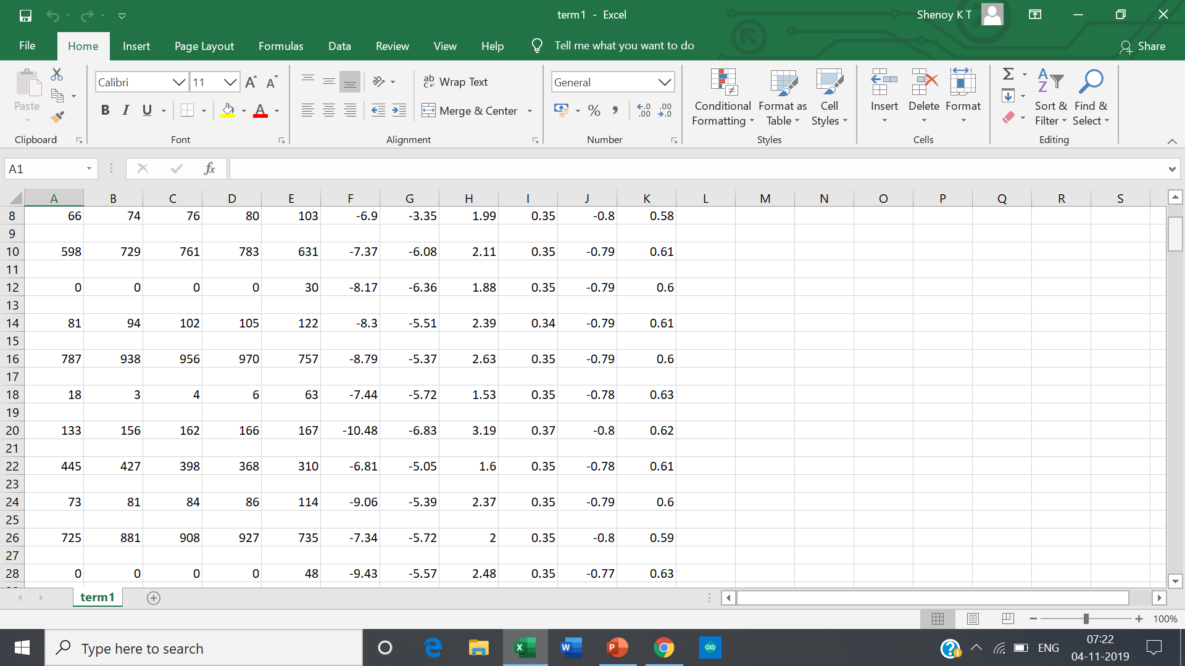
Tera term to csv file

Slide 17
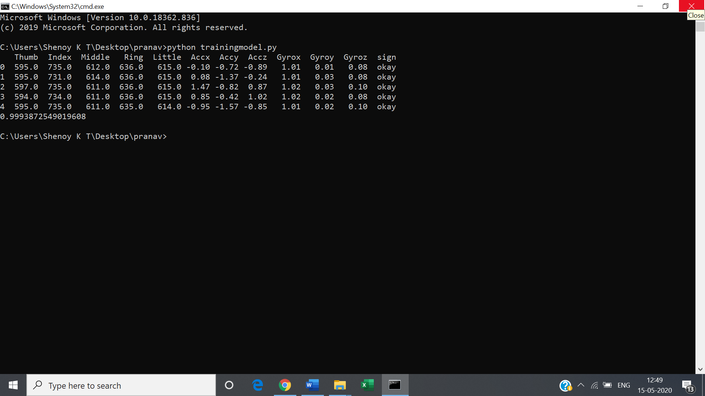
Output of the Training model

Slide 18
Hand Gesture and Output for Stop Sign
Hand Gesture and Output for Okay Sign

Slide 19
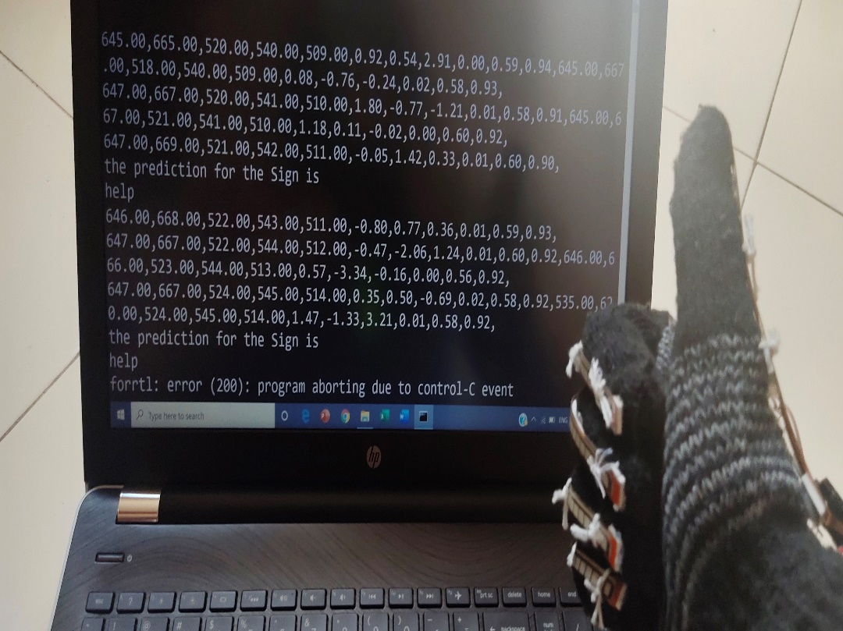
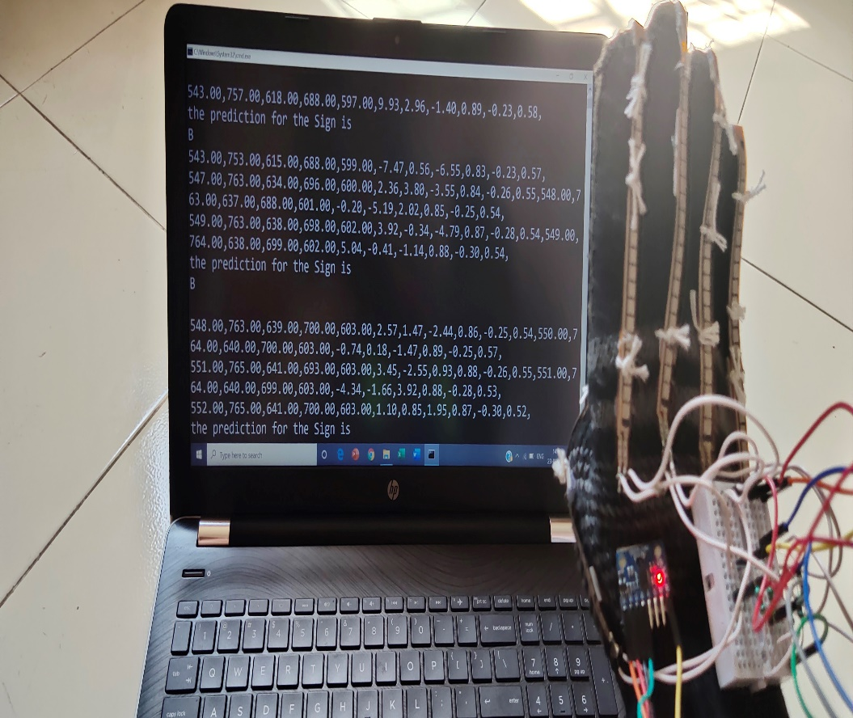
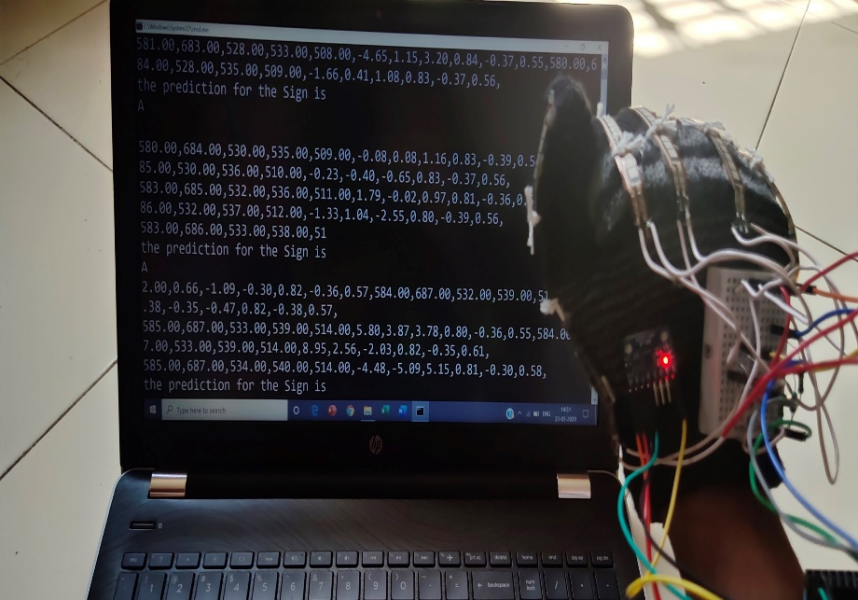
Hand Gesture and Output for Help Sign
Hand Gesture and Output for letter B
Hand Gesture and Output for letter A

Slide 20
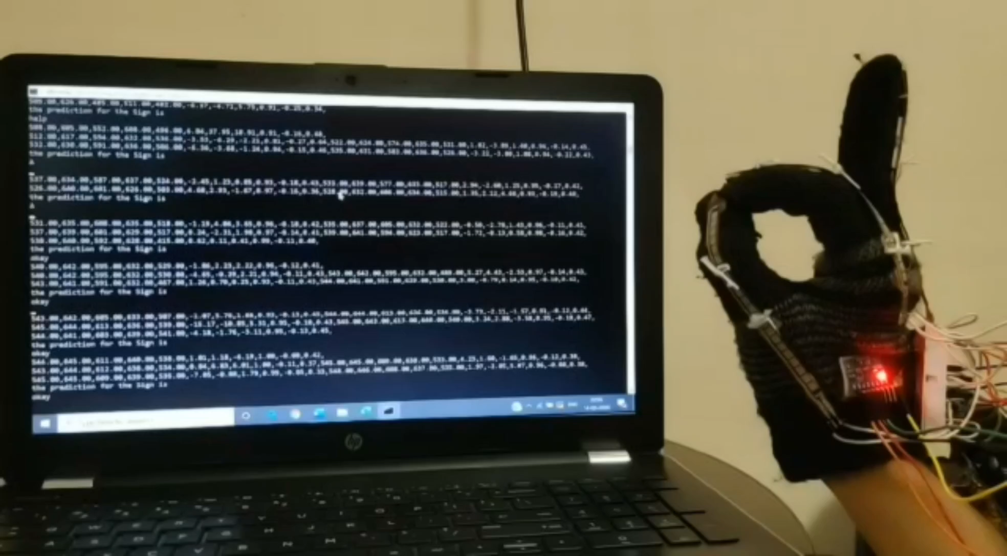
Real Time Working

Slide 21
APPLICATION AND FUTURE WORK
This system can be implemented in many application areas, examples include accessing government websites where no video clip for deaf and mute is available or filling out forms online where no interpreter may be present to help.
This project did not focus on facial expressions although it is well known that facial expressions convey important part of sign-languages.

Slide 22
CONCLUSION
High degree of accuracy can be obtained for the gesture recognition as per the amount of data made to train the machine.
Machine learning helps to predict the gesture with respect to the trained dataset.
The primary objective was to make a device that could read the sign language to help deaf and dumb people to be able to communicate more efficiently with normal people
This system will help them in improving their quality of life significantly.

Slide 23
REFERENCES
E.Hintom, S.SidenyFels and Geoffrey, "Glove Talk II- A neural network Interface which map gesture to parallel format speech synthesis controls," IEEE Transaction on neural networks, vol. 9, no. 1, 1998.
Harmeet Kaur, Amit Saxena, Abhishek Tandon, Keshav Mehrotra and Khushboo Kashyap, A Review Paper on Evolution of Smart Glove‖, International Journal of Scientific Research and 9Management Studies (IJSRMS), vol. 3, no. 3, pp. 124-128, 2016.
"Speakjet," Magnevation Speak Jet Inc. USA, 4 June 2010. [Online]. Available: http://www.speakjet.com/. [Accessed 5 January 2017].
Tushar Chouhan, Ankit Panse, Anvesh Kumar Voona and S. M. Sameer, "Smart Glove With Gesture Recognition Ability For The Hearing And Speech Impaired," in 38 IEEE Global Humanitarian Technology Conference- South Asia Satellite (GHTCSAS), September 26-27, 2014.

Slide 24
REFERENCES
Abhishek Tandon, Amit Saxena Keshav Mehrotra, Khushboo Kashyap, Harmeet Kaur, "A Review Paper on Smart Gloves- Converts Indian Sign Language(ISL) into Text and Speech," International Journal for Scientific Research & Development (IJSRD) , vol. 4, no. 8, pp. 269-272, 2016.
M. Deller, A. Ebert, M. Bender and H. Hagen, "Flexible gesture recognition for immersive virtual environments," in Tenth International Conference on Information Visualization (IV 2006), IEEE, July 2006.
T.K. Ho , "The Random Subspace Method for Constructing Decision Forests," IEEE Transactions on Pattern Analysis and Machine Intelligence

Slide 25
Thank you.

